Slide 1











PEP AI Capabilities and Range of Use-Cases
Classifying
Predicting
Explaining
Monitoring
Derive patterns and relationships from historical data to create decision-making guidelines that predict new data.
Apply trained models to new data using learned patterns to estimate the most probable outcome or category.
Provide actionable recommendations with supporting data to understand the decisions and predictions made by models, ensuring transparency.
Monitor model performance between predicted and actual outcomes to determine the need for model retraining.
Workflow
Illustrative Use Case Assembly:
Exception Management
Deviation and Outliers
Decision Optimization
QC Sampling
Recommendations
SSI Fails Management | Affirmation Prioritization | Inventory Management
NAV Variance
Inventory Management | Reconciliation Matching
Loan Document Review |
KYC Evaluation Level
Next Best Action | Assignment of Exceptions

Slide 2



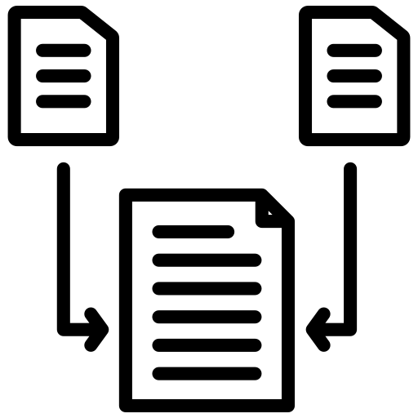




UDP AI Capabilities and Range of Use-Cases
Grouping
Reasoning
Extracting
Summarizing
Identify and categorize text data by comparison to a predefined set, or by grouping similar pieces of text data together from a large collection.
Identify similarities and differences based on meaning (semantics) and/or structure (syntax) of text data..
Identify and extract specific content that is pre-defined from a document and/or unique and common across a broad corpus.
Generate a summary version of a single lengthy document or generate a blended version of multiple documents.
Workflow
Illustrative Use Case Assembly:
Document Fusion
Business Data Extraction
Document Summarization
Quantitative Doc Validation
Exception Processing
G
R
E
S
G
R
E
E
S
E
E
PEP
Fund Administration – Equity, Fixed Income, & Alternative Funds | Procurement/ Legal Contracts Standardization
Reference Data (Billing, Derivative Contracts, Alts Pricing) | Loan Pricing Data
Corporate Actions
Fund Administration Tables Validation
KYC Document Review | Exception Processing (combo solution with PEP)

